Slide 1
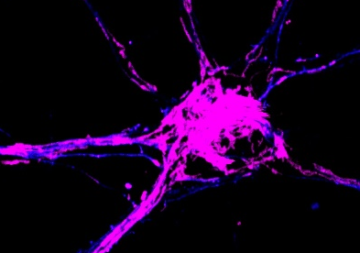
Announcing the 2018 Grant Cycle
Dr. Ralph and Marian Falk
Medical Research Trust Awards Programs
Catalyst Award
Program Focus:
The Catalyst Research Award Program provides one year of seed funding to support high-risk, high-reward projects that address critical scientific and therapeutic roadblocks within the Program’s principal areas of focus. The Program is designed to enable planning and development of projects, teams, tools, techniques and management infrastructure necessary to successfully compete for two-year awards through the Transformational Research Award Program.
Eligibility:
Invited Institutions (see Guidelines for list) may nominate up to two applicants who meet the following requirements:
Hold a full-time faculty appointment
Independent investigator with demonstrated institutional support and the specialized space and facilities needed to conduct the proposed research
Applicants may not have funding for a similar project
United States citizenship is not required; visa documentation is not required
PI may only submit one application
Online Application Deadline
*********************
(2:00 P.M., Eastern Daylight Time)
Award Amount
One-year awards of up to $300,000 (inclusive of 10% indirect costs)
Funding Period
11/30/2018 – 11/29/2019
Application Materials
& Invited Institutions https://hria.org/tmf/FalkCap/
Questions
Jeanne Brown
Program Officer
JBrown@hria.org
617-279-2240, x709
-
The Dr. Ralph and Marian Falk Medical Research Trust Awards Programs are managed by The Medical Foundation at HRiA

