Slide 1
Smith Family Foundation:
Odyssey Award
A Program of the Richard and Susan Smith Family Foundation
Pre- Application Informational Session
Applications Due:
Tuesday, December 17th at 12 PM ET
SmithOdyssey@hria.org
www.hria.org/tmf/smithodyssey
Notes:
Britta

Slide 2
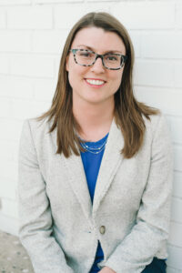
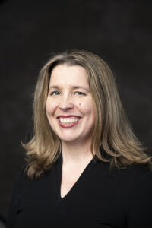
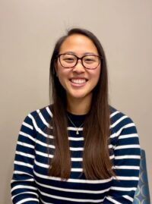
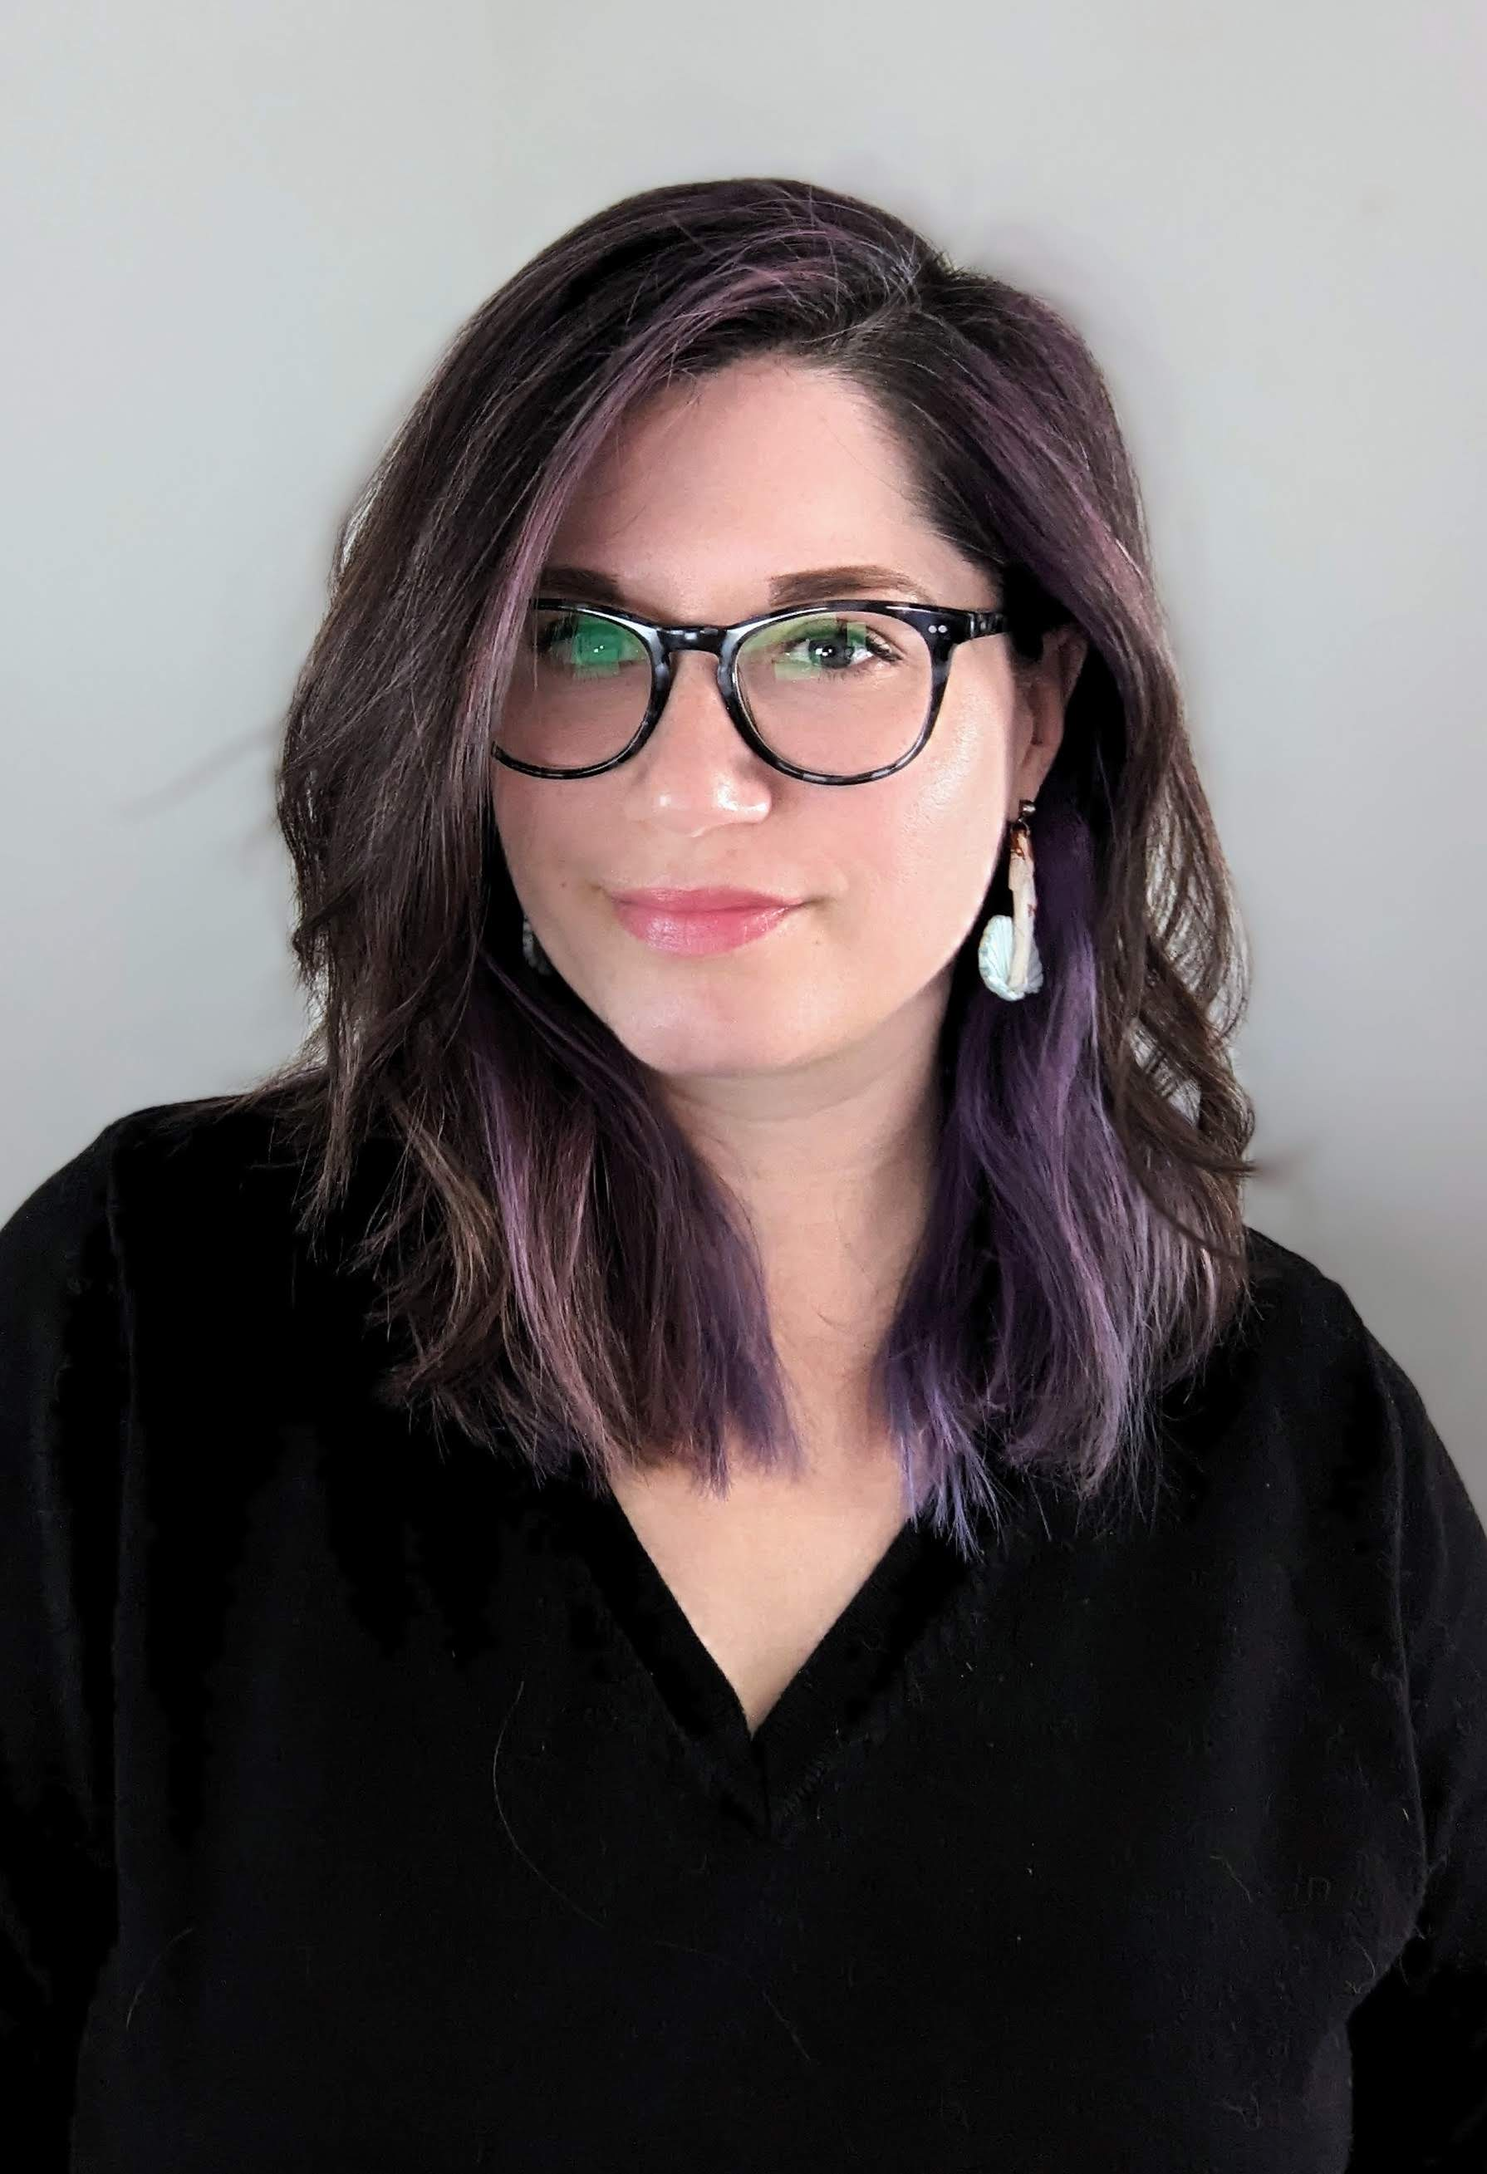
Who We Are
MEET OUR TEAM
Kristen Mueller, Ph.D. (she/her)
Chief Scientific Officer,
Biomedical Research Grantmaking
Britta Magnuson, D.M.D. (she/her)
Senior Scientific Advisor,
Biomedical Research Grantmaking
Tina Ta, M.S. (she/her)
Grants Officer,
Biomedical Research Grantmaking
Lyndsey Medlin, (she/her)
Grants Coordinator,
Biomedical Research Grantmaking
Notes:
Britta

Slide 3
HRiA partners with individuals, organizations, and communities to transform the practices, policies, and systems that improve health and advance equity.
Notes:
Britta

Slide 4
Agenda
Program Goals
Eligibility
Program Overview
Review Criteria
Proposal Writing Tips
Example of Reviewer Feedback
Q & A
Notes:
Britta

Slide 5
Smith Odyssey was created to support:
“the pursuit of high impact ideas to generate breakthroughs and drive new directions in biomedical research.”
Notes:
Britta

Slide 6


Program Goals
Short Term
Fuel creativity and innovation
Drive new research directions
Long Term
Achieve biomedical breakthroughs
Notes:
Tina
The Smith Family Foundation: Odyssey Award was created in 2017 to really try to fuel creativity and innovation in junior investigators (4-9 years from the award start date) in the basic sciences. Its focus is the pursuit of high impact ideas to generate breakthroughs and drive new directions in biomedical research. The awards will fund high-risk, high-reward pilot projects. Projects should be conceptualized as a novel research line and a distinct and novel-off shoot from the applicant’s current research

Slide 7
Eligibility
Applicant
Applicant has less than $750K per year in external funding
Received first independent faculty (tenure-track assistant professor) appointment on or between November 1, 2016 and November 1, 2021
Based at a nonprofit academic, medical, or research institution in MA or at Brown or Yale University
Research
Basic or translational biomedical research
Clinical trials are beyond the scope of this program
Note: Researchers may only apply to the Odyssey Award no more than 2 times
Notes:
Tina

Slide 8
Program Overview
Award Duration:
2 years
Award Amount:
(including 5% indirect costs)
$400,000
December 17, 2024
Application Deadline
Late May
Full Stage Applications Due
November 1, 2025
Award Start
October 31, 2027
Award End
Early March
Full Stage Invitation
Mid-October
Award Notification
Notes:
Tina

Slide 9
Review Criteria
APPLICANT
Important problem
Will advance biology
PROJECT
Clear question and rationale
Appropriate and feasible design
Potential for medical breakthrough
Makes sense in context of the field
Fully capable of carrying out the proposed research
Institutional commitment
IMPACT
INNOVATION
Novel research line
Distinct off-shoot of current research
Notes:
Tina
Impact ▪ The proposed basic or translational biomedical research addresses an important problem and has high potential to lead a fundamental advance in basic biology or a substantial advance in translational biology. In the longer term, the work has potential to generate a medical breakthrough. Applicant ▪ The applicant is fully capable of carrying out the proposed research and has clear ability to develop a sound research plan. ▪ The institution has demonstrated an appropriate level of commitment to her/him. ▪ Collaboration is an additional, but not required, positive ancillary factor. Research project ▪ Research question and hypothesis are clearly stated and are based on sound precedents and a clear rationale. Study design is appropriate to answer the question(s) and technically feasible. ▪ The proposal makes sense in the context ofthe pertinent literature and the work of other investigators in the field of study.

Slide 10
Proposal Writing Tips
Clear, concise, logical
Understandable language
Novelty
Distinct from ongoing work
Goals and metrics of success
Long-term goals
Notes:
Britta
Main points are communicated clearly and concisely. The big picture of what will be done, why it is important, and how it will advance the field is clear. • The language is understandable to a general scientific audience. The review board has a broad area of expertise, your proposal may not be reviewed an expert in your field. When jargon must be used, it is clearly explained, and complex technical points are put in context. • Specific aims and concise/essential background, experiments, and analysis plan are connected with clear logic, and key choices are justified. Sufficient detail about the approach is provided that the reviewers can clearly understand the proposed experiments. • Written responses answer the questions, and the use of references is appropriate. The writing is clear and does not overly rely on references to cheat the word count. • For applicants in crowded fields, the proposal makes clear how the study will bring a fresh perspective. Innovation and novelty in the field should not be overstated. Reviewers typically check this. • Goals and metrics of success are well-defined. • While the work must be feasible, top-scoring proposals typically have at least one ambitious aim. The preliminary proposal format is intended to give you the freedom to be creative. Reviewers do not look favorably on applications that look and feel like a shrunken, repurposed R01. • The impact of the work and how it will lead to a fundamental advance in basic biology or a substantial advance in translational biology should be clear. • Any appearance of scientific or budgetary overlap with other current or pending support is clearly described. Because Smith awardees are not allowed to accept funding that overlaps with the aims of the Smith project, we suggest applicants avoid proposing the same aims and budget in different grant applications. • Information about preprints and major papers in press is shared in the Biosketch

Slide 11
Example Reviewer Feedback – Critiques
Innovation
  “There is no explanation of how the proposed work is fundamentally different from the current focus. It is asserted that the work is different, but there is no real explanation, and it seems reasonably in line with the current focus of the lab.”
  “The proposal is not that innovative in that it basically proposes to simply to do this on a larger scale and with more automation.”
  “This is potentially not as large of a departure from current research as some other proposals.”
  "The PI has had similar funding to study this question."
  “The research is already a major component of the PI's research program and the proposed studies do not seem to define a new area of research.”
  “The objectives of this proposal are also very similar to those of many other research programs in this field.”
Notes:
Britta

Slide 12
Example Reviewer Feedback - Critiques
Too Vague
  “The methods that will be used to study xxxxx are not clearly described.”
  “Proposal includes a large quantity of unexplained acronyms and hyper-technical jargon making it difficult to understand what exactly is being proposed in some areas.”
  “The core finding is so cool that the vagueness of the Aims are disappointing.”
  “Relationship of the proposed work to the applicant’s current research is not described clearly.”
  “The proposed studies are not clear enough to fully assess. Project is too vague and it is difficult to evaluate the experiments proposed.”
  “Even with limited space, the description is too vague to understand many of the approaches to be taken. As such, it is hard to know how impactful the work might be.”
Notes:
Britta

Slide 13
Example Reviewer Feedback - Critiques
Grantsmanship
  “Although the format used fits in the space guidelines provided, I think it is a stretch in the sense that the 'simple timeline' was used as a specific aims page.”
  “The description of the Aims relies too heavily on a reference list containing 22 citations. This format dampens enthusiasm because a framework for what will be done is not provided.”
  “Please make sure that any figures incorporated into a proposal are very clear for a reader, including a generalist. A well-crafted figure can convey 1000 words, but one that isn't well crafted can be confusing or just take up precious space.”
Notes:
Britta

Slide 14
Example Reviewer Feedback - Critiques
Other
  Research Focus: “A weakness is proposing two different screens in one proposal. It would be stronger to propose one screen and demonstrate more ability to be able to characterize targets.”
  Power: “The investigator should, I think, be more ambitious to obtain useful data. At the scale proposed here, it is not clear that much of value will be achieved.”
  Impact: “While admittedly there is much still to learn in this area, it is not clear what new insights will be gained from these studies.”
  Overstatement: “I find the proposal OK, but not great, and in many cases a bit overhyped: “My research will bring ----- to the forefront of the ----- field” - The ----- field has already been focused on ----- for years."
Notes:
Britta

Slide 15
Example of Reviewer Feedback - Strengths
The depth of the analysis and creativity is clear, this one really stands out in regards to it helping build the PI's career.
The approach is unique, the proposal is strong and multifaceted.
The research proposal is clearly defined and comprises a straightforward plan. The PI has assembled a team which is well qualified to help with the effort.
Notes:
Britta

Slide 16
Questions?
Applications Due:
Tuesday, December 17th at 12 PM ET
SmithOdyssey@hria.org
www.hria.org/tmf/smithodyssey
Notes:
Tina

Slide 17

View the Office Hours Recording HERE

