Slide 1
RWJF Culture of Health Prize Alumni Storytelling Cohort
Submitting your Application Online
Michelle Stuart and Albaney Gray, Health Resources in Action
Michael Crawford and Claire de Leon, Spitfire Strategies

Slide 2
Overview
Access application link and resources
Create a grantmaking portal account
How to submit your application
2

Slide 3
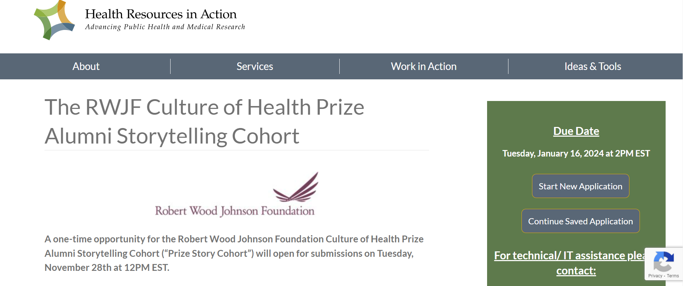

Access Application and Resources
Visit this webpage: The RWJF Culture of Health Prize Alumni Storytelling Cohort to
Learn more about the Prize Story Cohort opportunity
Access the RFP, application link, essay template and other supporting resources on the green right-hand side tool bar.

Slide 4
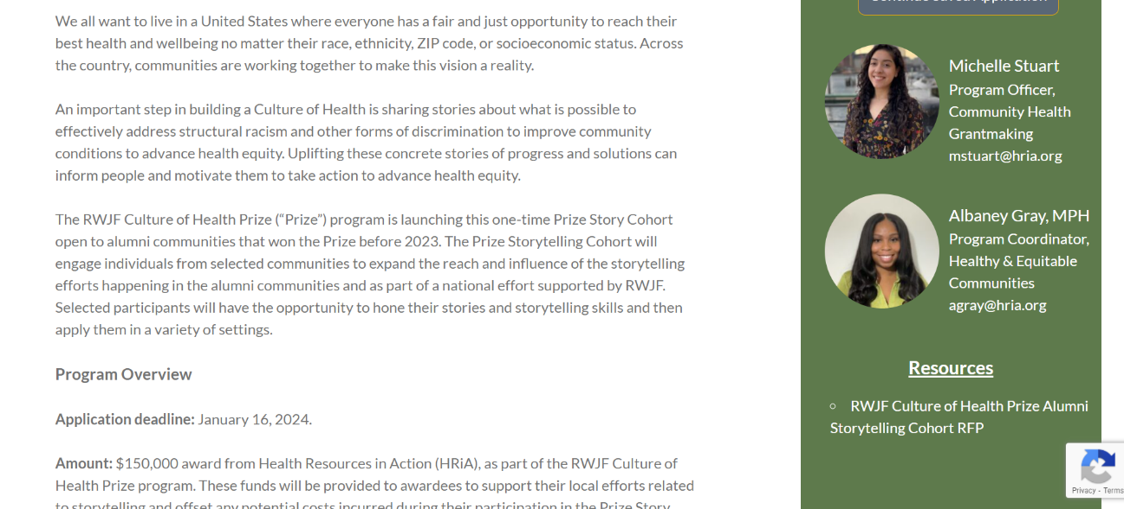
Access Application and Resources
Supporting resources can be found at the bottom of the green right-hand side tool bar.

Slide 5
Create Online Application Portal Account
Who should create an account and submit an application?
Your organization’s Primary Contact
What is the role of a primary contact?
A primary contact is the ongoing point person for the Prize and owner of the grantmaking portal account for your organization.
The Prize management team may contact this person with updates and questions throughout the program.
Your primary contact person may change throughout the period of the program. If this happens, please update the Prize management team, in order for us to update it in the system.
?

Slide 6
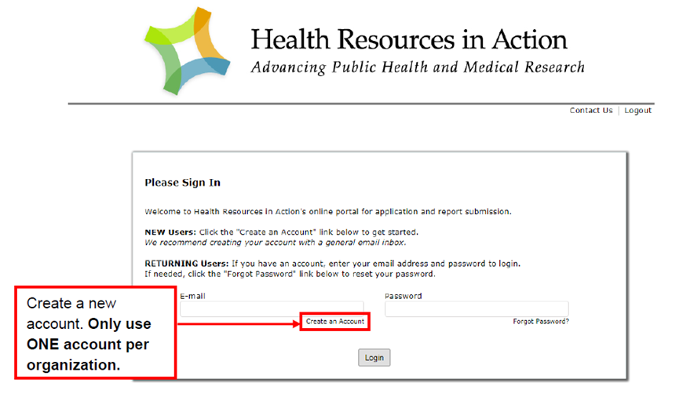
Create Grantmaking Portal Account
If your organization has never submitted an online application via HRiA’s online portal, use the following instructions:
Go to this link: https://us.grantrequest.com/application.aspx?sid=2364&fid=35364
Select "Create an account.“
Follow the link to create an account for your organization.
Otherwise, log in using your existing account details.

Slide 7
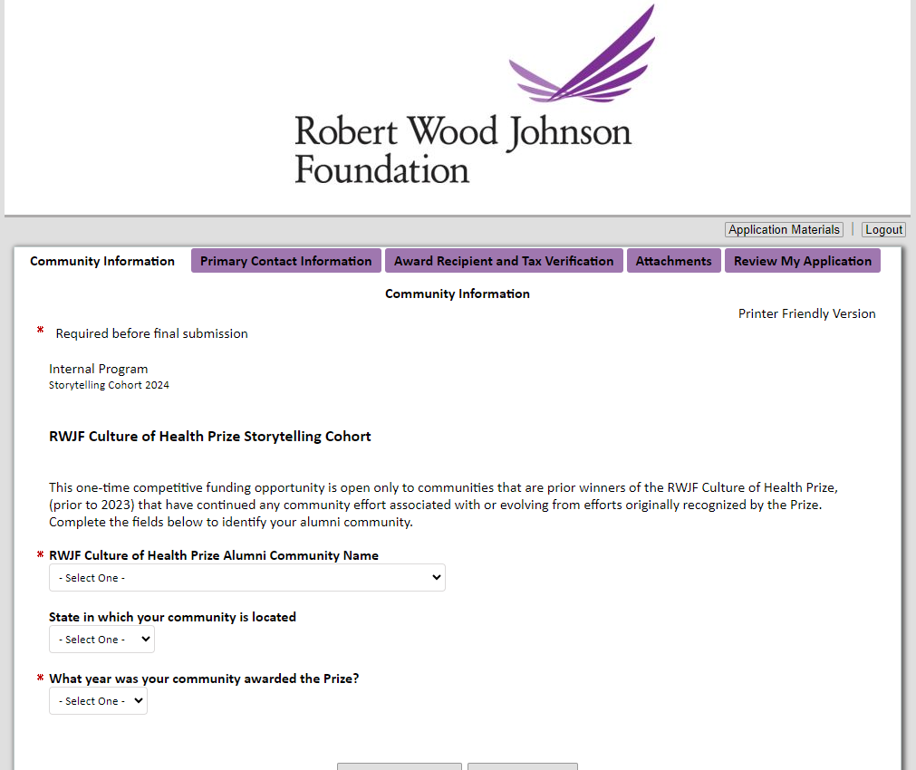
How to Submit Your Application
Once you have created an account, you will be brought directly to the application page.

Slide 8
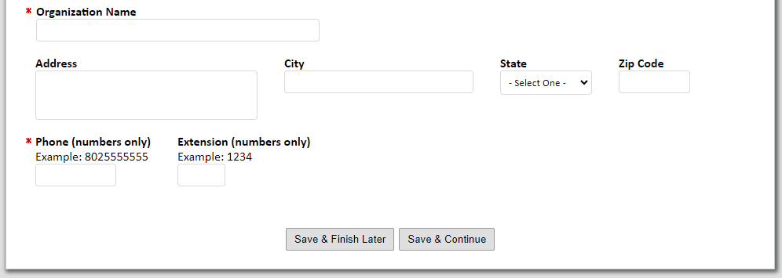
How to Submit Your Application
As you are filing the application be sure to select “Save & Continue” at the bottom of each section.
If you would like to pause the application, be sure to select “Save and Finish Later” before exiting out of the page.

Slide 9
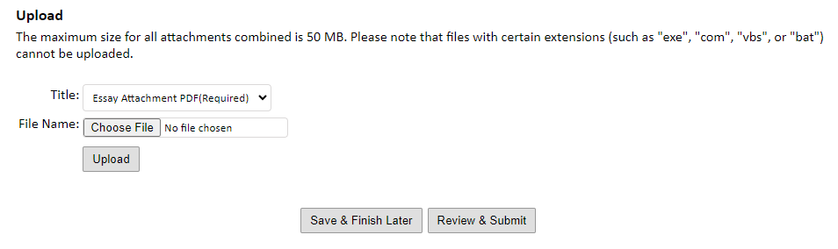
How to Submit Your Application
Once you get to the essay portion of your application be sure to use the essay template provided on the application webpage: The RWJF Culture of Health Prize Alumni Storytelling Cohort , as instructed on slide #3.
Essay Submission Instructions:
Make sure to convert to PDF for upload
Ensure your PDF is titled "PrizeStoryCohort_CommunityName_2024"
After attaching your PDF file click upload
Click "Review & Submit" at the bottom of the application page

Slide 10

How to Submit Your Application
Once you click on "Review & Submit" you will be directed to the "Review my Application" page. Which allows you to edit and correct any errors noted by the system.
If you make any changes to your application, make sure to click "Update"
To officially submit your application, click "Submit"
  Please ensure to review your application and your attached PDF as no edits/changes can be made after submission.

Slide 11
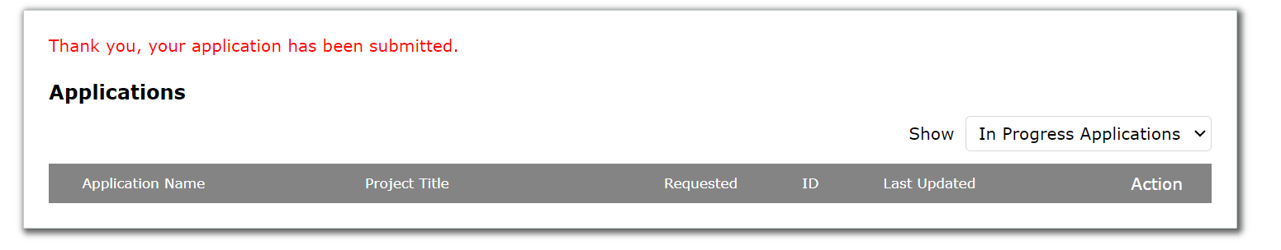
How to Submit Your Application
Once you have submitted your application you will see this confirmation message in your portal account. You should also receive a confirmation email titled, "Submission Confirmation: The Robert Wood Johnson Foundation Culture of Health Prize Alumni Storytelling Cohort," with your application tracking number.
If you do not receive this email reach out to Michelle Stuart and Albaney Gray at CultureOfHealthPrize@hria.org for technical assistance.

Slide 12

Questions?
If you need technical/IT assistance with your application, please contact
Michelle Stuart or Albaney Gray at CultureOfHealthPrize@hria.org
If you need assistance with the content of your application, please contact Michael Crawford or Claire de Leon at
CultureOfHealth@spitfirestrategies.com
12

