Slide 1
RWJF Culture of Health Prize Alumni Storytelling Cohort Request for Proposals
Informational Webinar
Michelle Stuart, Health Resources in Action
Michael Crawford, Spitfire Strategies Kristiana Jordan, Spitfire Strategies
December 2023

Slide 2
What We’ll Cover Today
About the opportunity
Application process overview
Questions and discussion

Slide 3
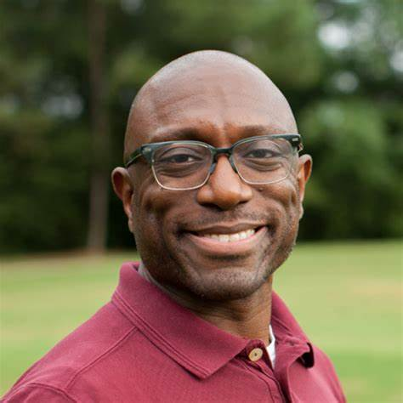
Michelle Stuart
Program Officer, Health Resources in Action (she/her)
Michael Crawford
Vice President, Spitfire (he/him)
Kristiana Jordan
Director, Spitfire (she/her)

Slide 4
RWJF Culture of Health Prize
Honoring the work of communities where people and organizations are collaborating to advance health, opportunity, and equity for all.

Slide 5
About the Opportunity
What will cohort members receive?
A $150,000 award.
Training from Spitfire Strategies to enhance story development and storytelling with media, policymakers, advocacy networks, and grassroots organizations.
Opportunities to expand networks by connecting with other Prize communities, as well as national and local leaders working to build a Culture of Health.
Support from Spitfire Strategies in bridging relationships with priority audiences, which can include policymakers and journalists.

Slide 6
About the Opportunity
Why a storytelling cohort?
Progress is made when people like you doing the work share your stories and solutions.
Real, lasting policy, systems, and environmental change requires changing how people think about what is necessary and possible.
Your storytelling will serve as inspiration to other communities, policymakers, and practitioners and build demand for systematic change to advance health equity.
Sharing stories about what is possible, helps to effectively address structural racism and other forms of discrimination.

Slide 7
Application Process
Nov. 28–Jan. 16
Open for submissions
Week of Feb. 12
Notification of applicant status
Week of March 4
Virtual interviews with finalists
April 2024
Notification of selected participants and start of cohort

Slide 8
Applications Must…
Demonstrate the breadth of work and collaboration happening across the community and across multiple sectors that reflects the spirit of the 2023 Prize selection criteria, especially criterion 1: Addressing structural racism and other structural injustices to create conditions that advance health equity;
Describe the alignment of this ongoing work in the applicant community with the focus of the intended storytelling efforts, with the 2023 Prize selection criteria in mind;

Slide 9
Applications Must…
Demonstrate interest and ability to actively participate in the cohort over the 12-month period, with clear description of how participation will benefit the community’s local change efforts;
Please identify one person from your community who will be the person to consistently participate in the cohort, drive local storytelling efforts and share info with other community partners; ​
Demonstrate that the proposed cohort participant plays a relevant role in the community to serve as a lead in driving storytelling efforts and local change efforts.

Slide 10
Commitment
Awardees will identify one consistent person from the community who will participate in a 12-month Prize Story Cohort. This person will:
Participate in select virtual cohort gatherings and one in-person meeting with Spitfire Strategies throughout the award period.
Participate in four to six virtual cohort-related trainings and monthly coaching sessions with Spitfire Strategies.
Engage with Spitfire Strategies to shape storytelling strategies and identify storytelling communications opportunities specific to the community’s focus and priorities.

Slide 11
Commitment
4. With Spitfire’s support, identify, pursue, and enable two communications opportunities and leverage four to six local media efforts to gain regional, state, and national audiences and influence over the course of the Prize Story Cohort.
5. Actively connect the storytelling work back with relevant community partners and the local change work in the community related to the Prize.
6. Attend the 2024 Prize winners' celebration event and alumni gathering to share learnings from participation in the cohort and stories developed.
7. Upon completion of the Prize Story Cohort, present stories, accomplishments, and impact of participation in the cohort on advancing your community’s work to the Prize program team.

Slide 12
Review Process
Who will review applications?
What to keep in mind that reviewers will be looking for:
The breadth of work and collaboration happening across the community and across multiple sectors.
Alignment of the work with the intended storytelling efforts and the spirit of the 2023 Prize and its selection criteria.
Interest and ability to actively participate in the cohort over the 12-month period, with clear description of how participation will benefit the community’s local change efforts.

Slide 13
2023 Prize Selection Criteria
Addressing structural racism and other structural injustices in order to create conditions that advance health equity.
Committing to sustainable policy, systems, environmental and cultural changes.
Working alongside partners across sectors, and elevating the expertise and solutions held by people with firsthand experiences of health inequities.
4. Engaging in cultural work that envisions and advances a more just future.
5. Making the most of available community resources and fostering sustainability.
6. Measuring and sharing qualitative and quantitative indicators of progress in culturally relevant ways.

Slide 14
Navigating the Application
All applications for this funding opportunity must be submitted via the HRiA portal.
Visit the Prize Story Cohort webpage to access the application link, resources on how to create an account in the HRiA portal and apply on the right-hand side tool bar.
Applicants will be asked to submit an essay (limit 4 pages). These questions and instructions for submission can be found on the RFP, linked on the webpage.
Finalists will be interviewed virtually.

Slide 15
Questions and Discussion

Slide 16
Thank you
Contact CultureOfHealthPrize@HRiA.org with any questions.

