Slide 1
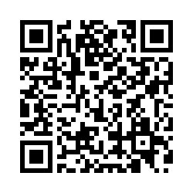
Let’s improve the health of our community together!
YOUR voice matters.
RWJBarnabas Health, its hospitals, affiliates, and community partners are conducting a Community Health Resident Survey
YOUR INPUT can help shape future programs and services
Together, survey responses will be used to make our communities healthier and safer, so that all residents can thrive here
The survey is available in 8 languages and will only take about 15 minutes to complete.
https://bit.ly/rwjb24

